Slide 1
natural numbers, Primes and Multi-Layered Perceptrons
Nathan hall
Rohan Saha

Slide 2
Common Tests to Find Characteristics of Natural Numbers
Fibonacci Numbers - Selfridge’s Conjecture Lucas Numbers - Baillie-PSW Exponentiation - Fermat’s Little Theorem (FLT), Selfridge, Baillie-PSW Mod 4 - Gaussian Factorization Mod 5 - Selfridge Mod 6 - General Arithmetic Property Mod p - Wilson, Baillie-PSW, FLT

Slide 3

General Arithmetic Properties
All primes, > 3, are of the form 6n $±$ 1, where n is a Natural number.
Ex. Let n = 1. Then:
6n – 1 = 5
6n + 1 = 7

Slide 4

Wilson’s Theorem
(p – 1)! $≡$ -1 mod p
Ex. Let p = 5. Then:
(5 – 1)! (mod 5)
= 4! (mod 5)
= 4 * 3 * 2 (mod 5)
= 24 (mod 5)
$≡$ 4 (mod 5)
$≡$ -1 (mod 5)

Slide 5

Selfridge Conjecture
Given p = 2k + 1 and p $≡$ $±$ 2 (mod 5), if $2^{p−1}$ $≡$ 1 (mod p) and $f_{p+1}$ $≡$ 0 (mod p), then p is prime. *$f_{n}$ is the nth Fibonacci number.
Ex. Let p = 7, then: $2^{7−1}=2^{6}=64≡1$ (mod 7) and $f_{7+1}=f_{8}=21≡0$ (mod 7). Hence, 7 is prime
This is still an open problem

Slide 6

Baillie-PSW ( Sulfridge )
Ex. Let p = 5, then: $2^{5−1}=2^{4}=32≡1$ (mod 7) and $L_{5+1}=L_{6}=11≡0$ (mod 7). Hence, 7 is prime
Same as Selfridge’s Conjecture, but substitute Lucas numbers for Fibonacci numbers.

Slide 7
Fermat’s Little Theorem
Fermat’s Little Theorem:
a^(n-1) congruent 1 mod n

Slide 8
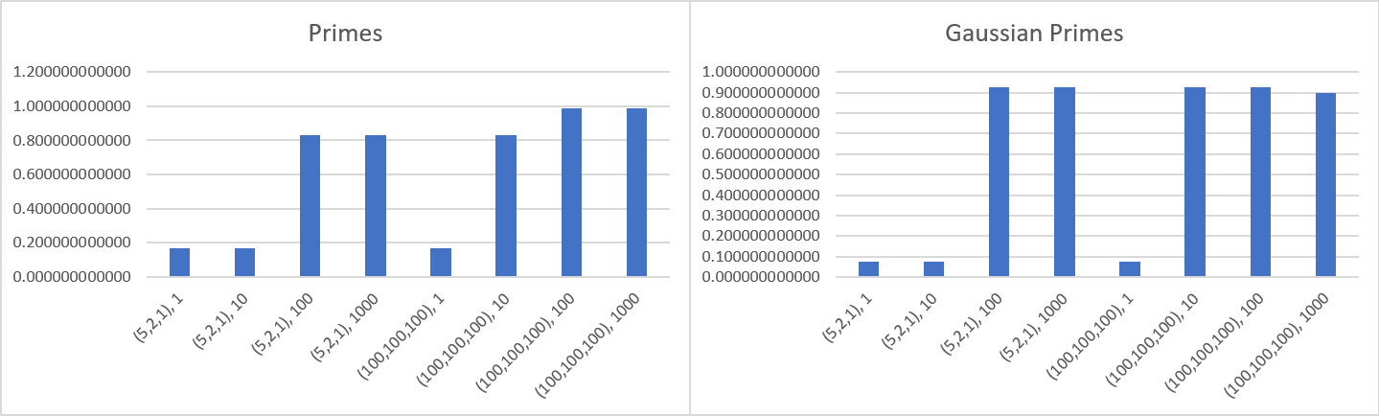

Slide 9
Future Attributes to Analyze:
More bases for Fermat’s Little Theorem Coprimes Members of Curves and Intersections of Sack’s Spiral Diagonals of Ulam’s Spiral Attributes of Lenstra’s Elliptic Curve Factorization

Slide 10
Goals for Future Work
To see if a set of n attributes can achieve a high accuracy of predicting prime/compositeness of a given number.
Find a novel set of attributes to create a new sieve algorithm.
Find a novel set of attributes to find primes/pseudoprimes.
Find if a subset of primes can be reliably identified. Find a correlation between different spiral, or spiral like, organizations of natural numbers and the probability of being prime. i.e. prime density If so, attempt to use Genetic Programming to see if progress can be made on the Twin Prime Conjecture.

Slide 11
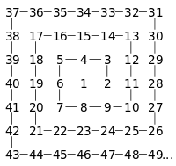

Slide 12
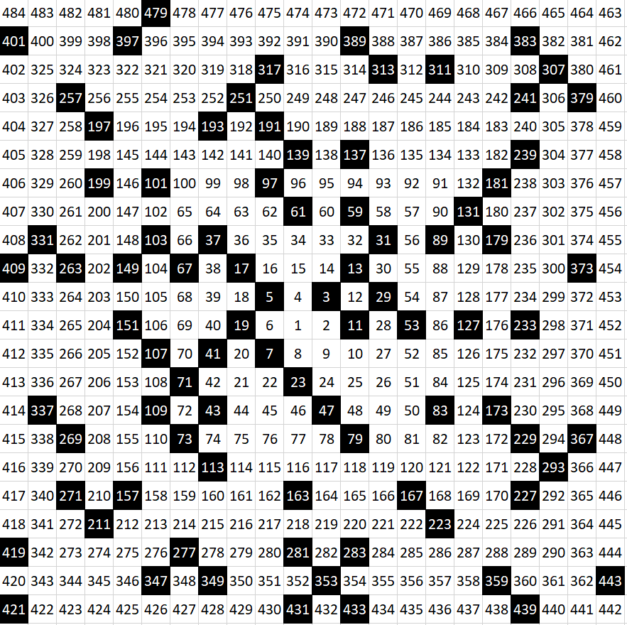
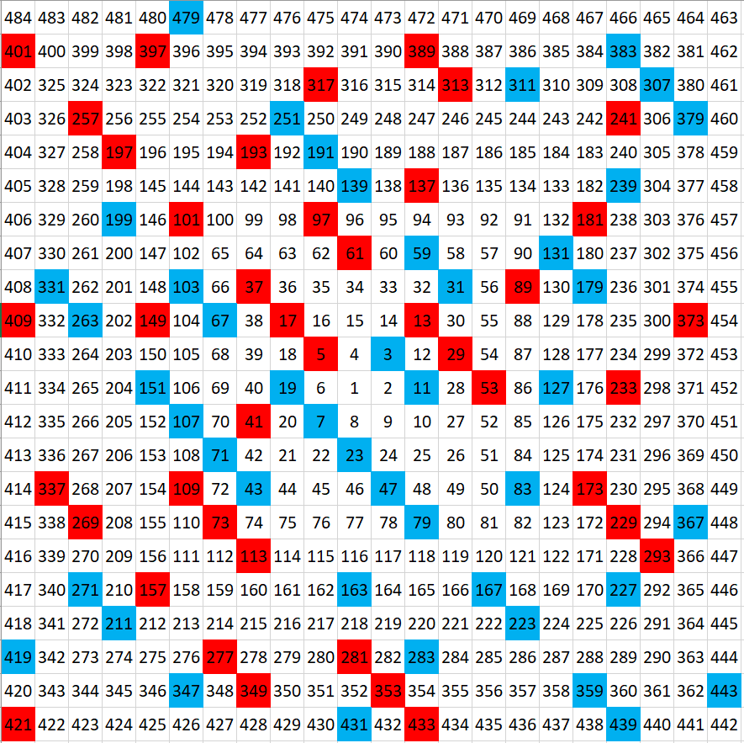

Slide 13
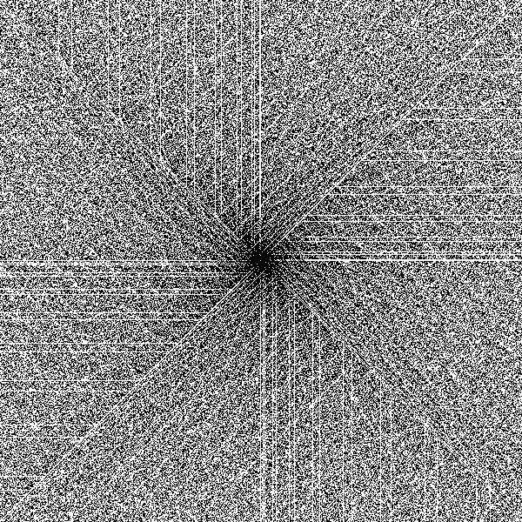

Slide 14
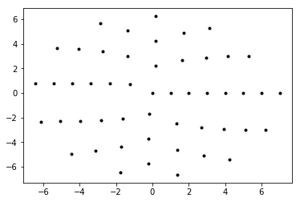
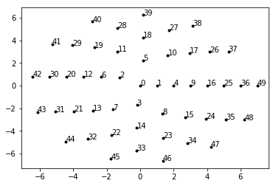
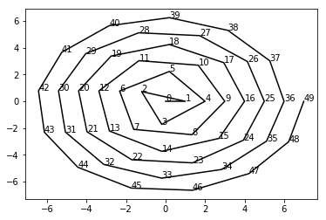

Slide 15
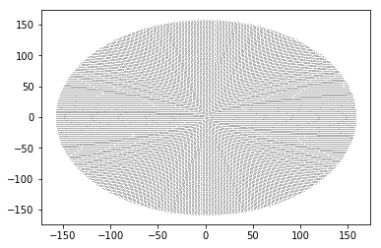
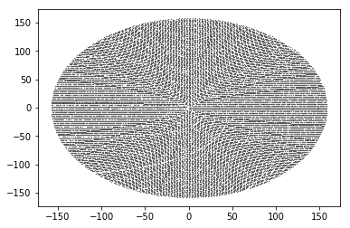
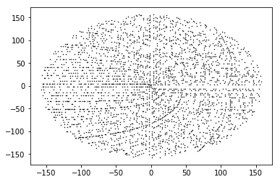
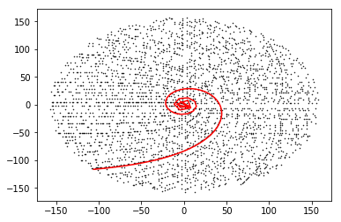

Slide 16
